Slide 1
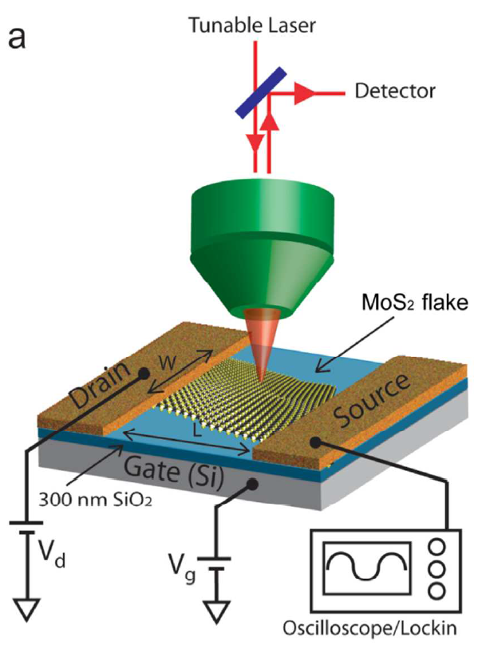
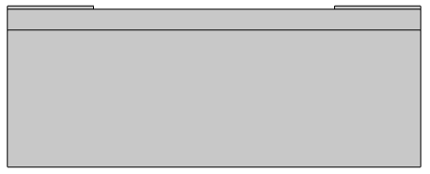
MoS2 FET

Slide 2
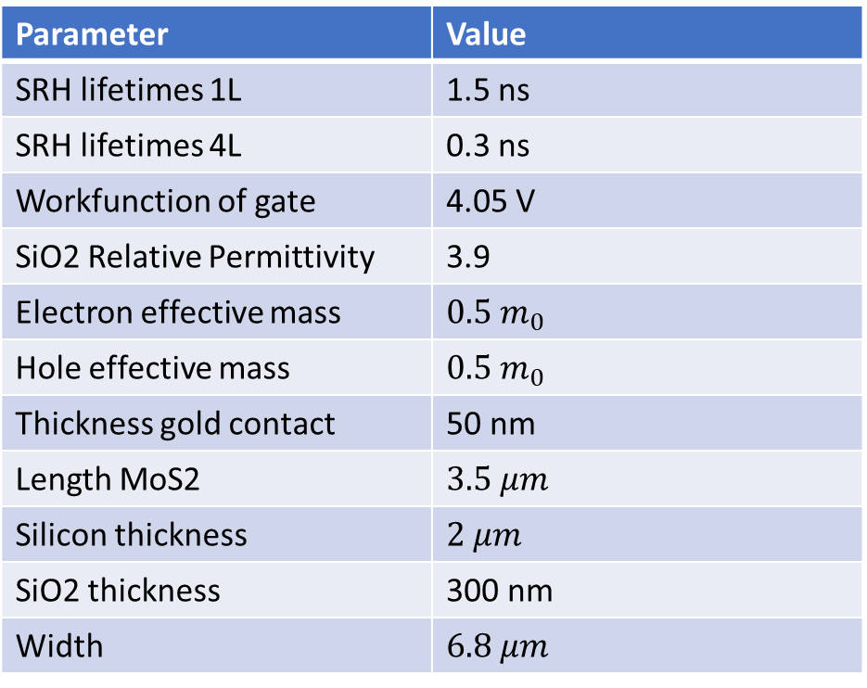
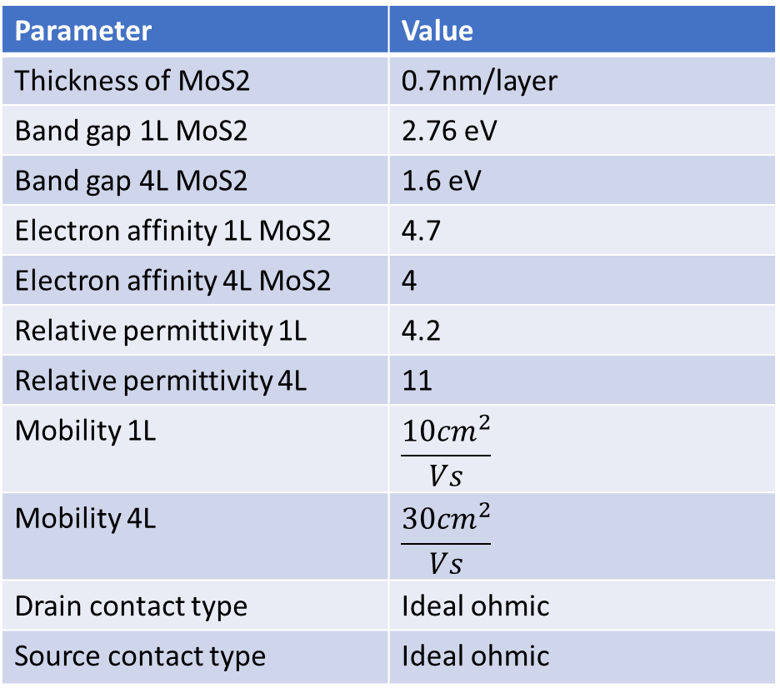
Parameter | Value
Thickness of MoS2 | 0.7nm/layer
Band gap 1L MoS2 | 2.76 eV
Band gap 4L MoS2 | 1.6 eV
Electron affinity 1L MoS2 | 4.7
Electron affinity 4L MoS2 | 4
Relative permittivity 1L | 4.2
Relative permittivity 4L | 11
Mobility 1L | $$\frac{{10cm}^{2}}{Vs}$$
Mobility 4L | $$\frac{{30cm}^{2}}{Vs}$$
Drain contact type | Ideal ohmic
Source contact type | Ideal ohmic
Parameter | Value
SRH lifetimes 1L | 1.5 ns
SRH lifetimes 4L | 0.3 ns
Workfunction of gate | 4.05 V
SiO2 Relative Permittivity | 3.9
Electron effective mass | $${0.5 m}_{0}$$
Hole effective mass | $${0.5 m}_{0}$$
Thickness gold contact | 50 nm
Length MoS2 | $$3.5 μm$$
Silicon thickness | $$2 μm$$
SiO2 thickness | 300 nm
Width | $$6.8 μm$$

Slide 3
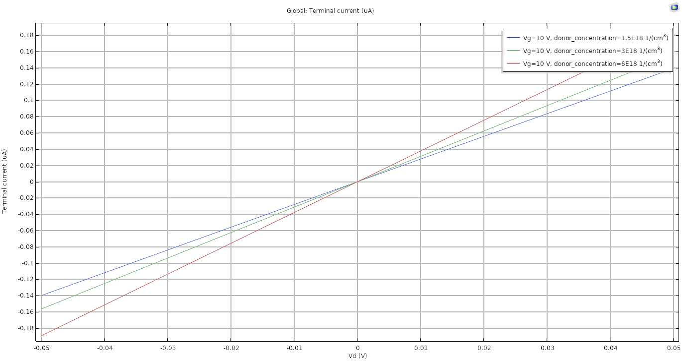
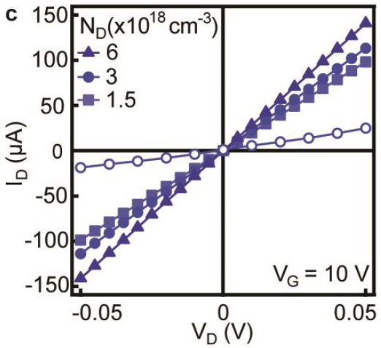
Output characteristics when $V_{g}=10V$ for a 1L thick FET.

Slide 4
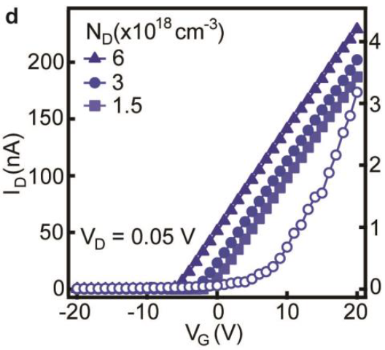
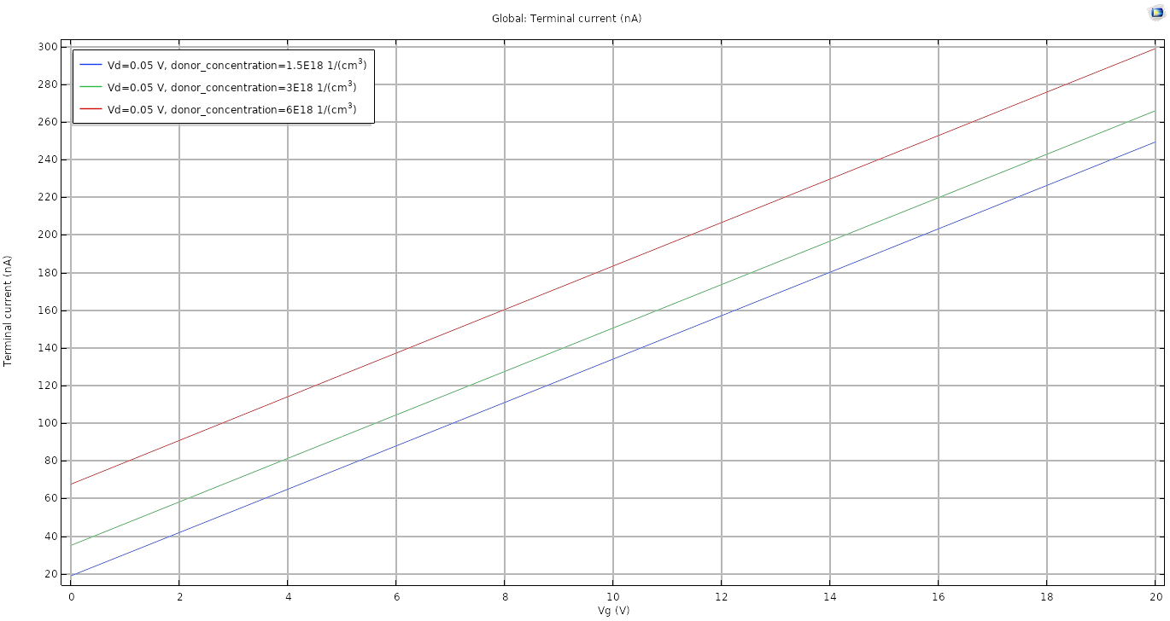
Transfer characteristics when $V_{d}=0.05 V$ for a 1L thick FET.

Slide 5
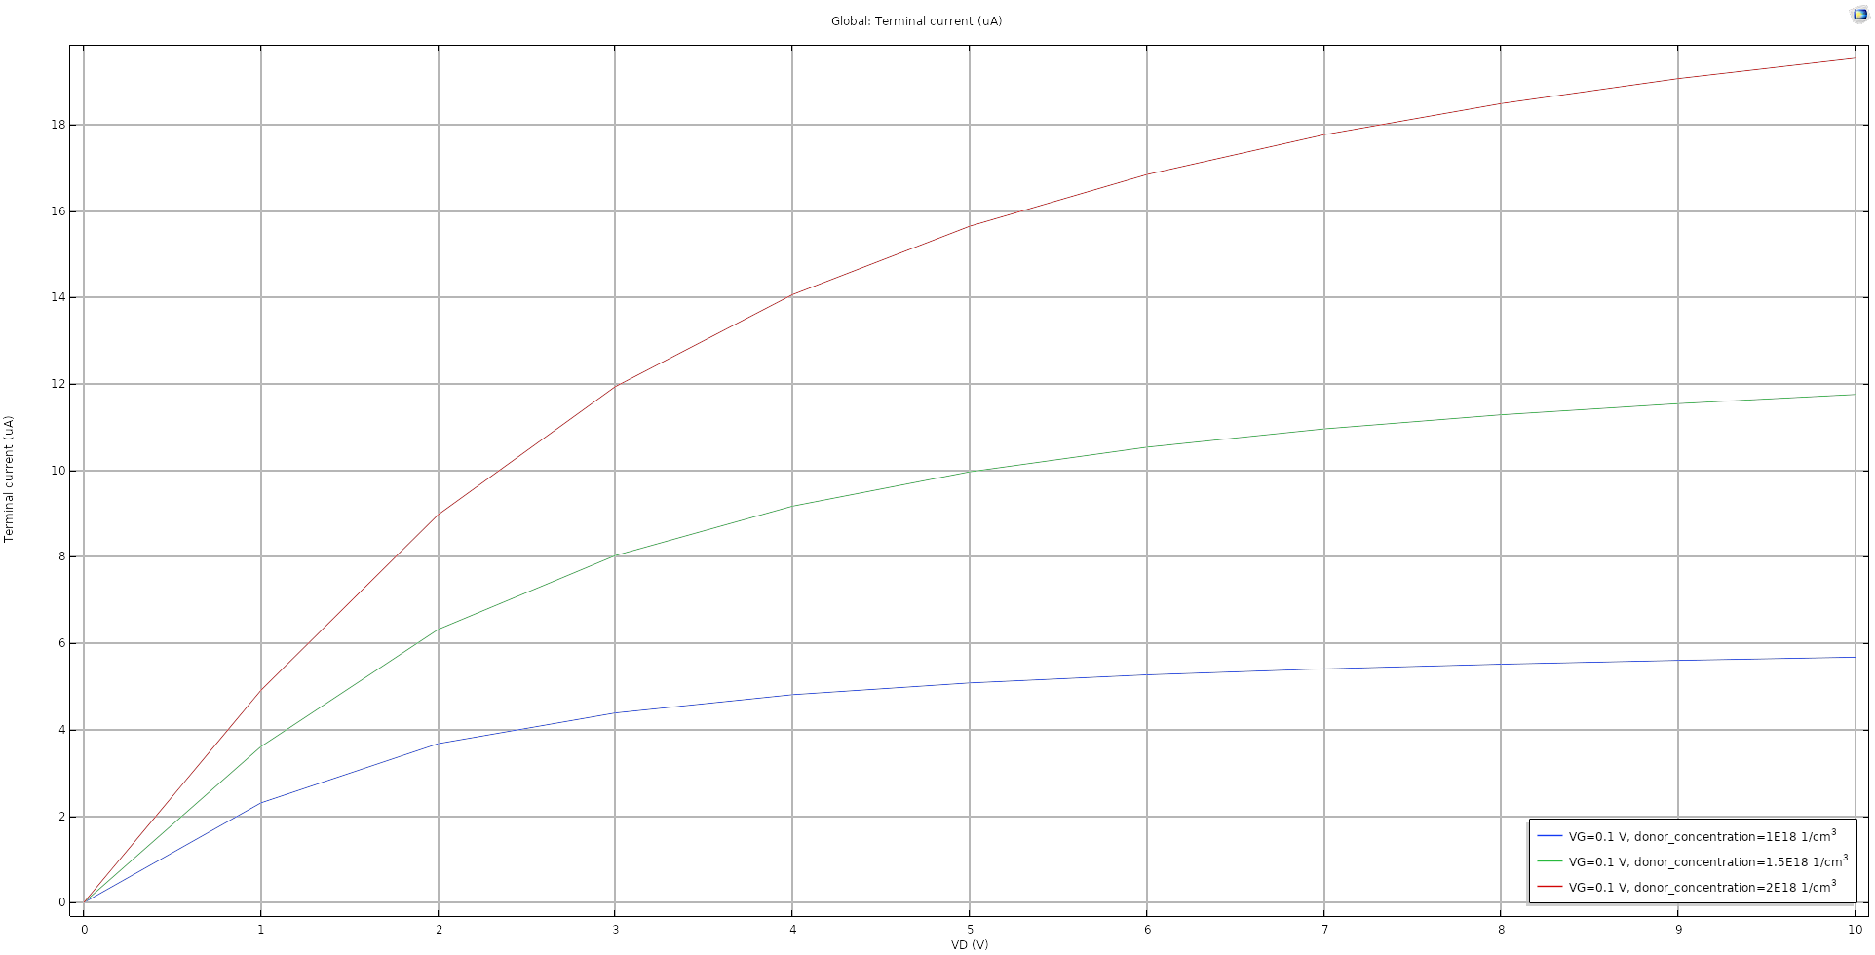
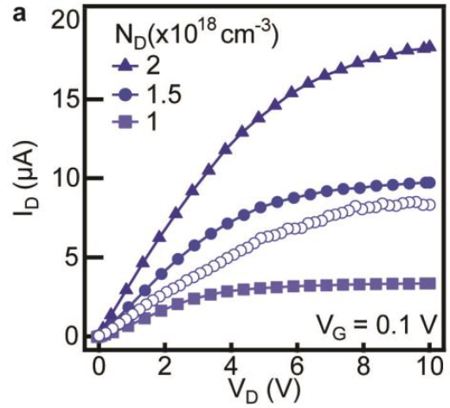
Output characteristics when $V_{g}=0.1 V$ for a 4L thick FET.

Slide 6
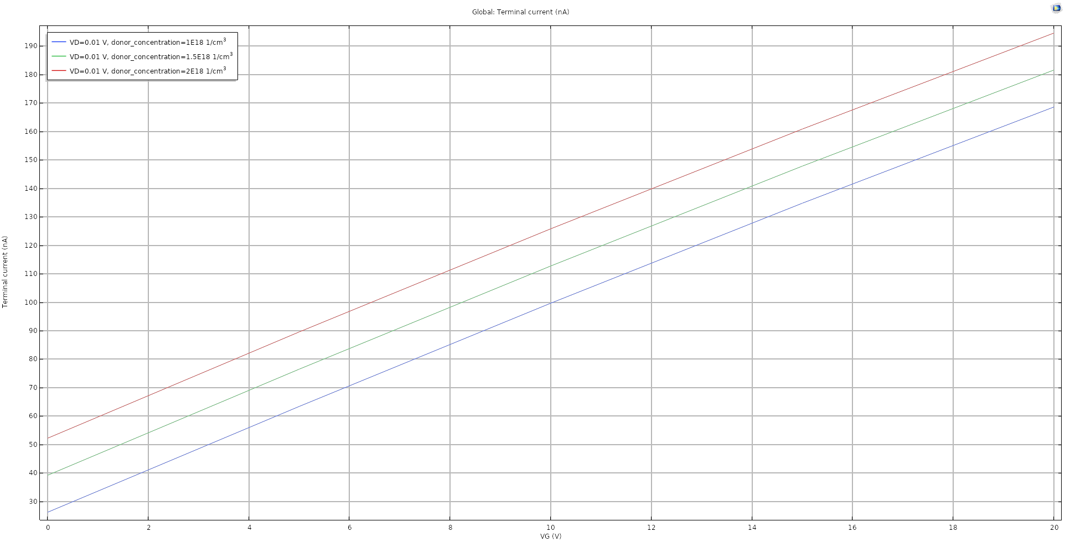
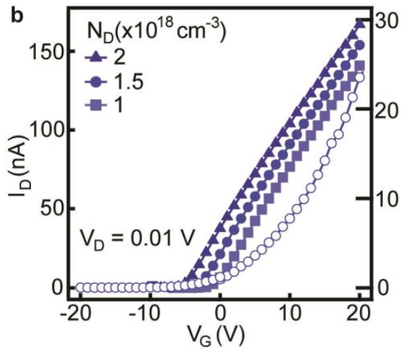
Transfer characteristics when $V_{d}=0.01 V$ for a 4L thick FET

Slide 7
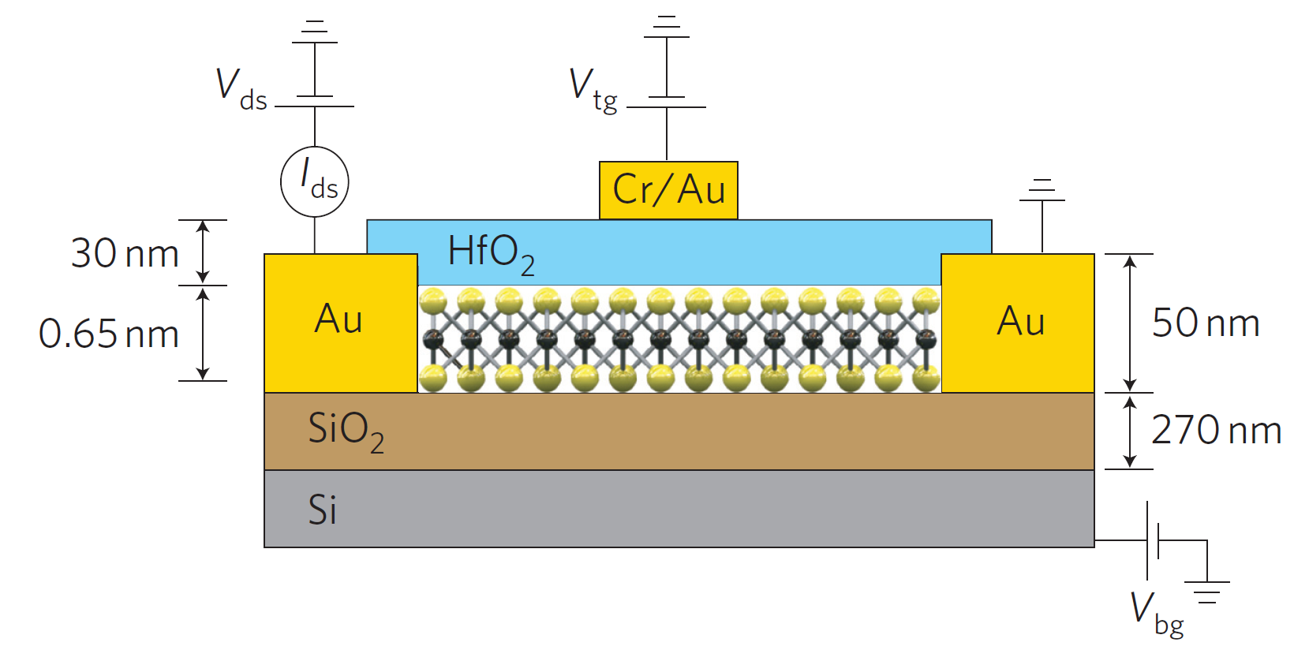
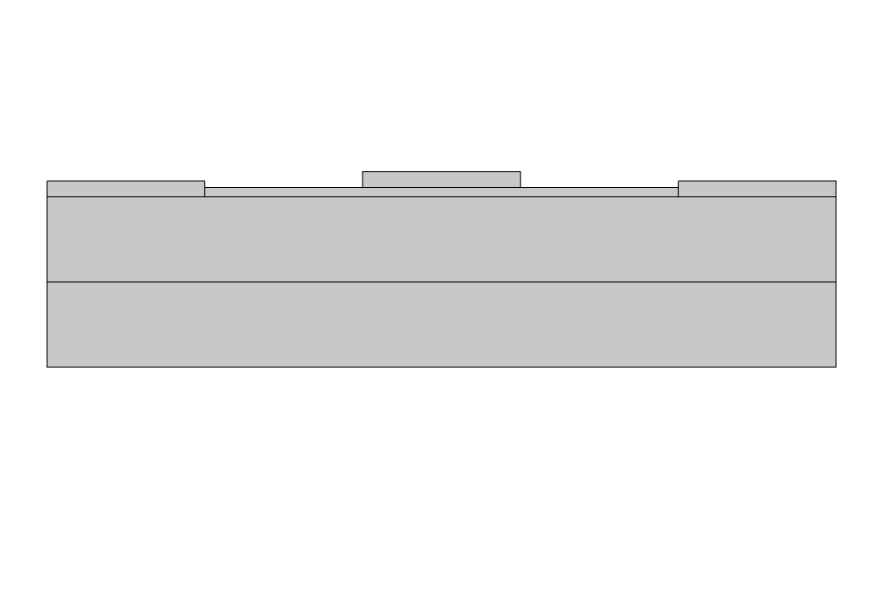
MoS2 con HfO2

Slide 8
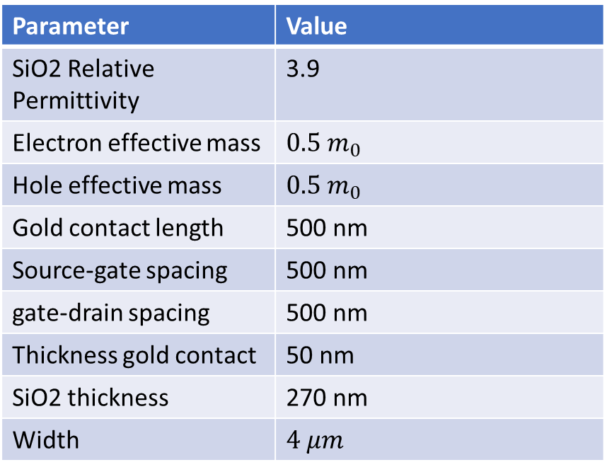
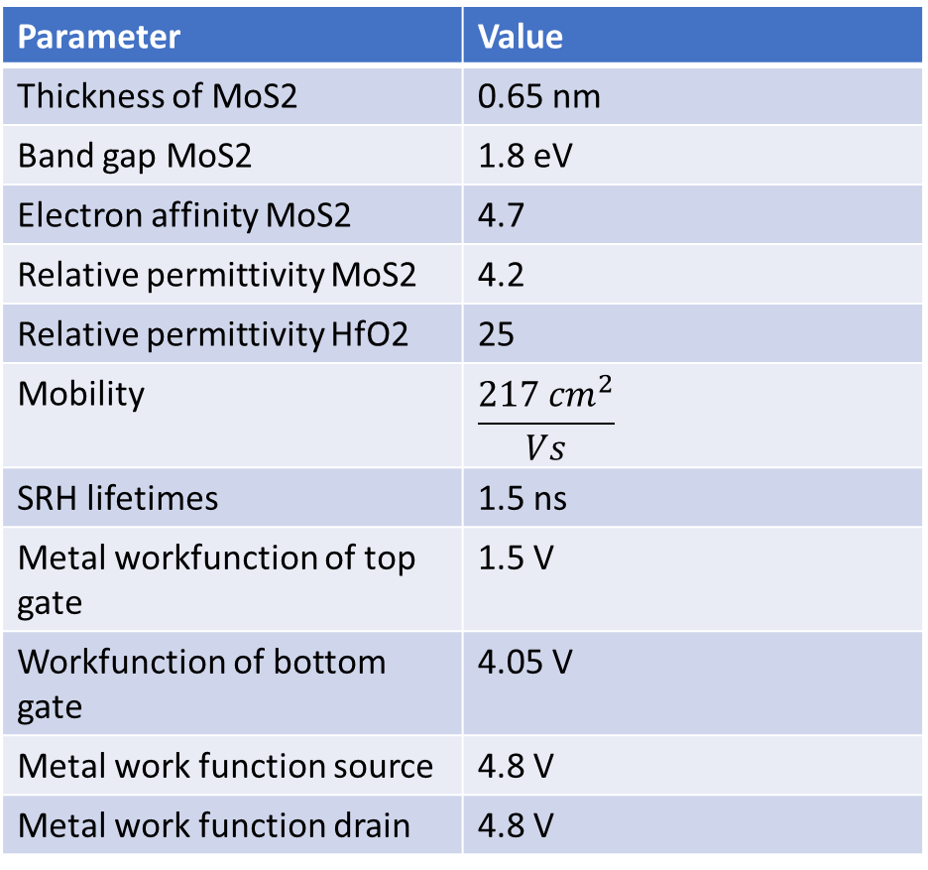
Parameter | Value
Thickness of MoS2 | 0.65 nm
Band gap MoS2 | 1.8 eV
Electron affinity MoS2 | 4.7
Relative permittivity MoS2 | 4.2
Relative permittivity HfO2 | 25
Mobility | $$\frac{{217 cm}^{2}}{Vs}$$
SRH lifetimes | 1.5 ns
Metal workfunction of top gate | 1.5 V
Workfunction of bottom gate | 4.05 V
Metal work function source | 4.8 V
Metal work function drain | 4.8 V
Parameter | Value
SiO2 Relative Permittivity | 3.9
Electron effective mass | $${0.5 m}_{0}$$
Hole effective mass | $${0.5 m}_{0}$$
Gold contact length | 500 nm
Source-gate spacing | 500 nm
gate-drain spacing | 500 nm
Thickness gold contact | 50 nm
SiO2 thickness | 270 nm
Width | $$4 μm$$

Slide 9
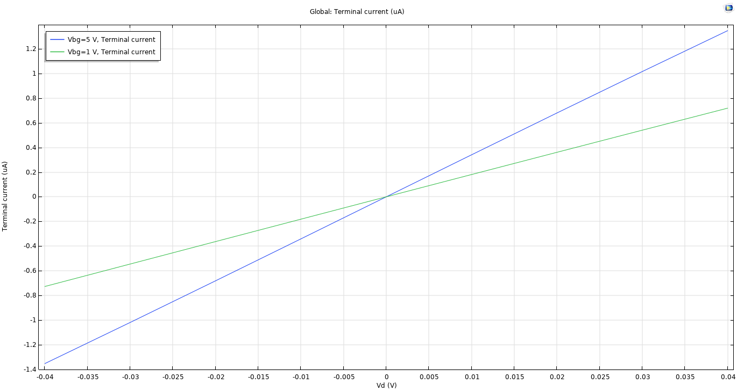
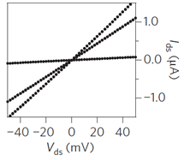
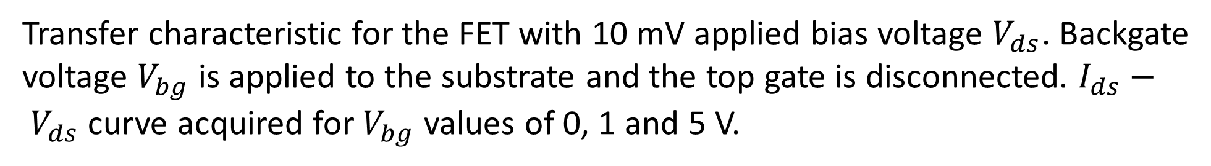
Transfer characteristic for the FET with 10 mV applied bias voltage $V_{ds}$. Backgate voltage $V_{bg}$ is applied to the substrate and the top gate is disconnected. $I_{ds}− V_{ds}$ curve acquired for $V_{bg}$ values of 0, 1 and 5 V.

Slide 10
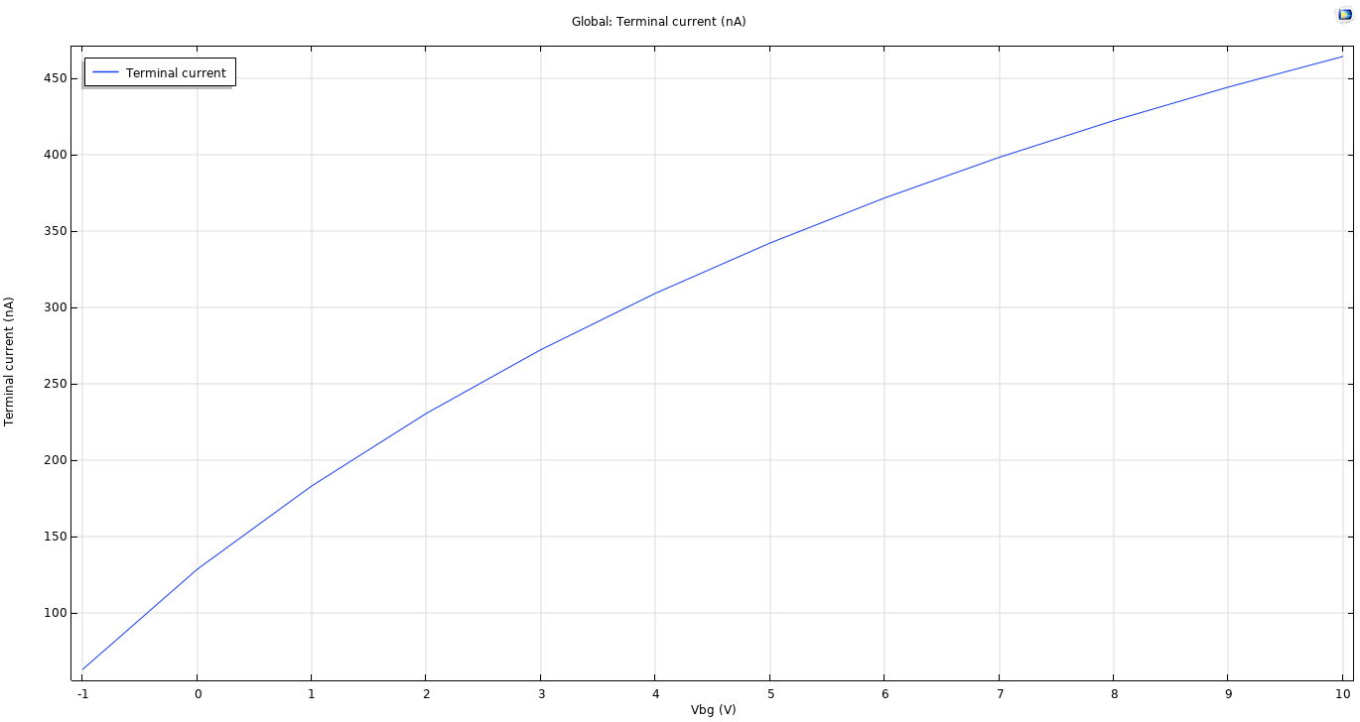
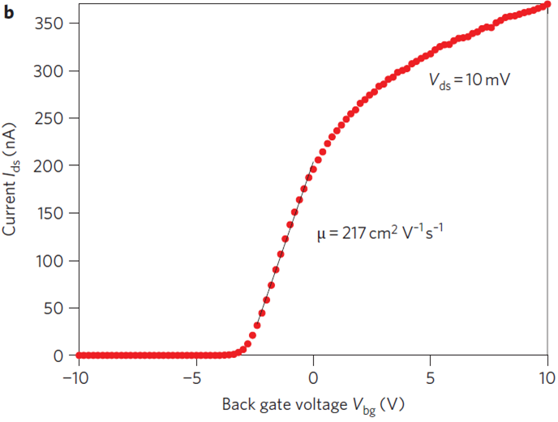
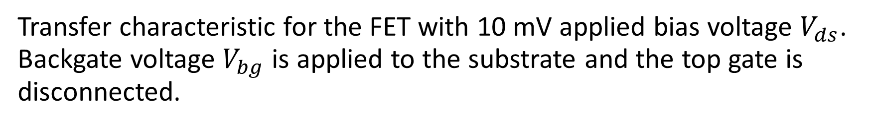
Transfer characteristic for the FET with 10 mV applied bias voltage $V_{ds}$. Backgate voltage $V_{bg}$ is applied to the substrate and the top gate is disconnected.

Slide 11
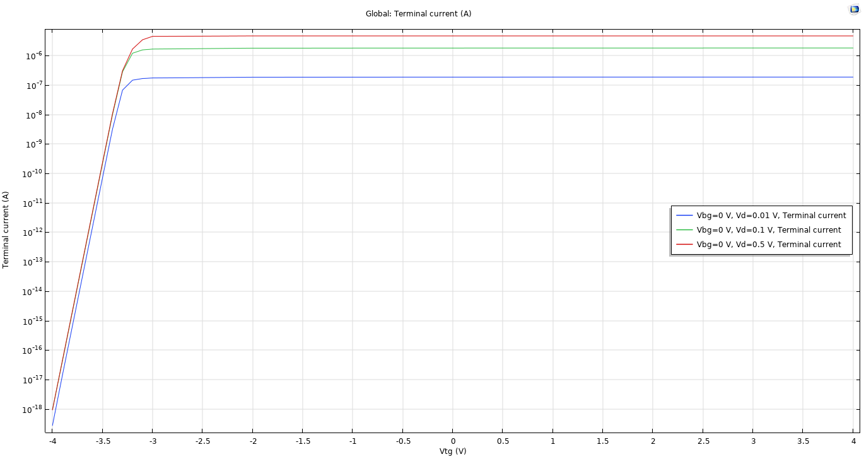
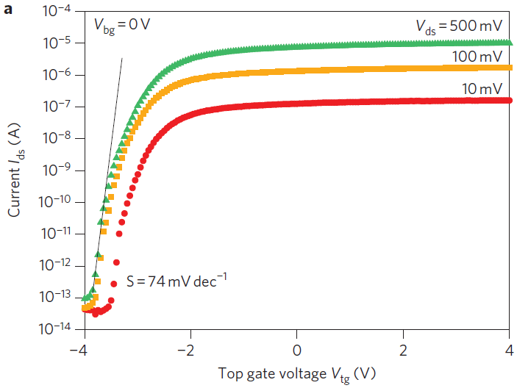
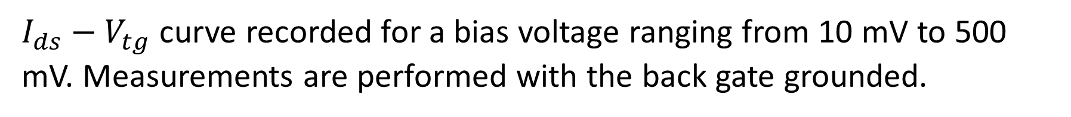
$I_{ds}−V_{tg}$ curve recorded for a bias voltage ranging from 10 mV to 500 mV. Measurements are performed with the back gate grounded.

Slide 12
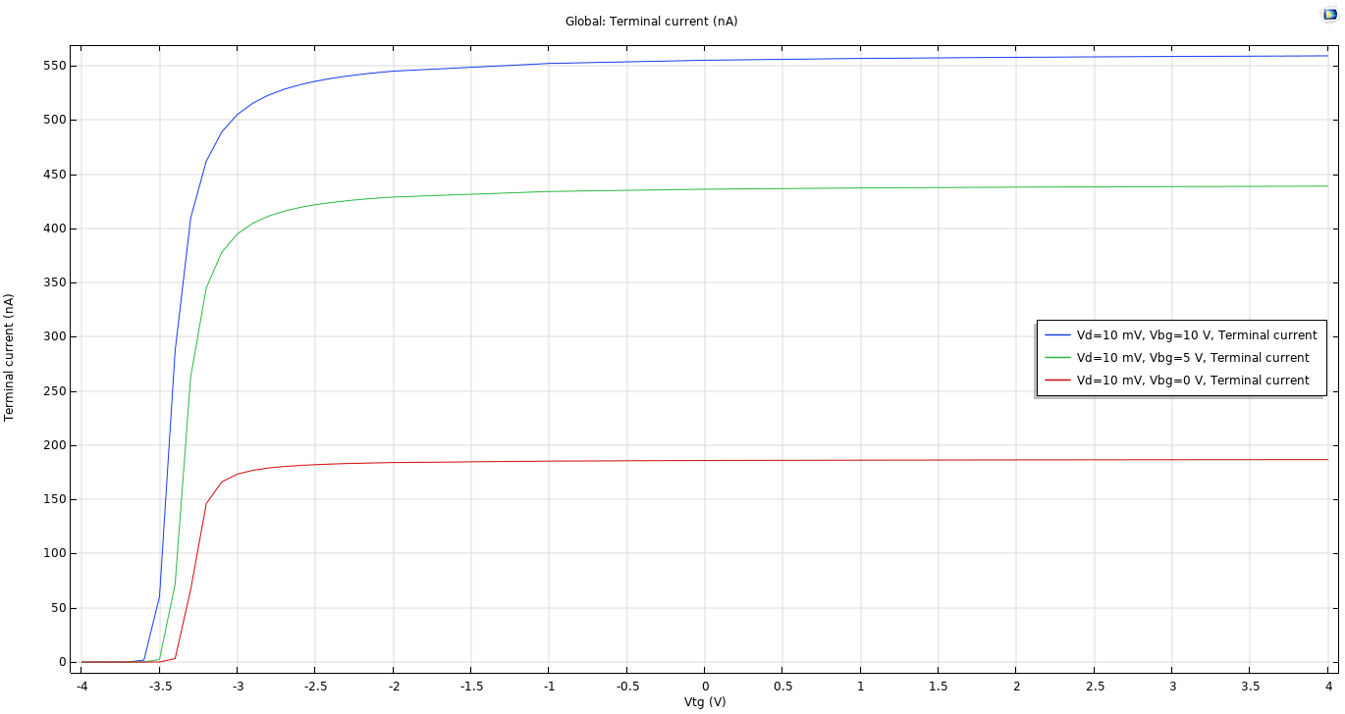
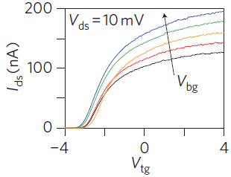
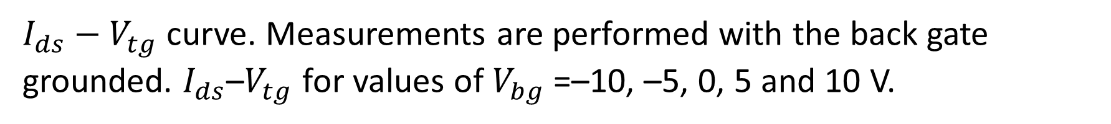
$I_{ds}−V_{tg}$ curve. Measurements are performed with the back gate grounded. $I_{ds}$–$V_{tg}$ for values of $V_{bg}$=–10, –5, 0, 5 and 10 V.

Slide 13
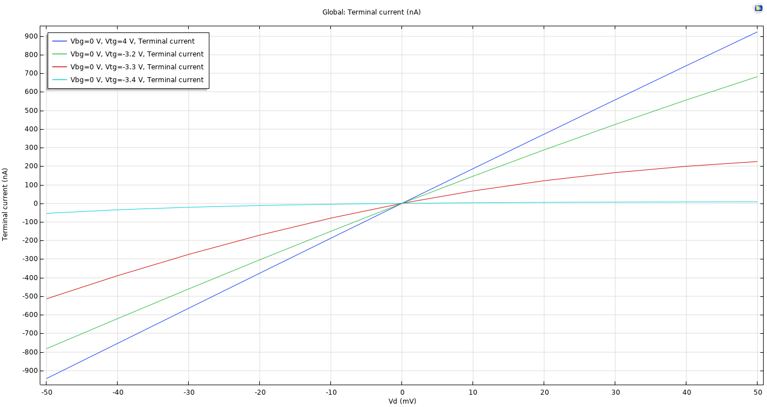
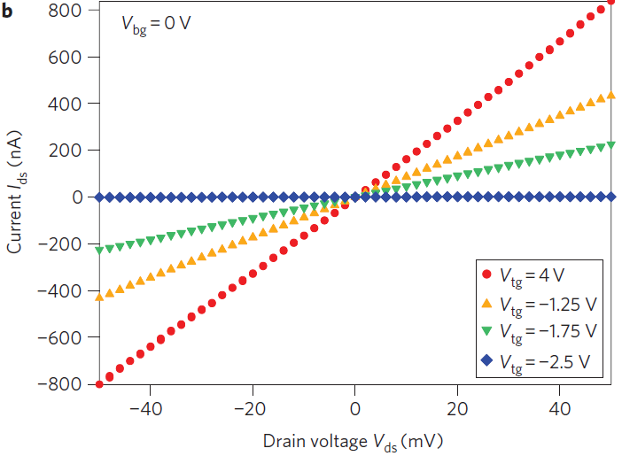
$I_{ds}−V_{ds}$ curves recorded for different values of $V_{tg}$.

